Slide 1
Amazon sales data analysis tableau final work done
File created on: 18-04-2024 22:00:19

Slide 2
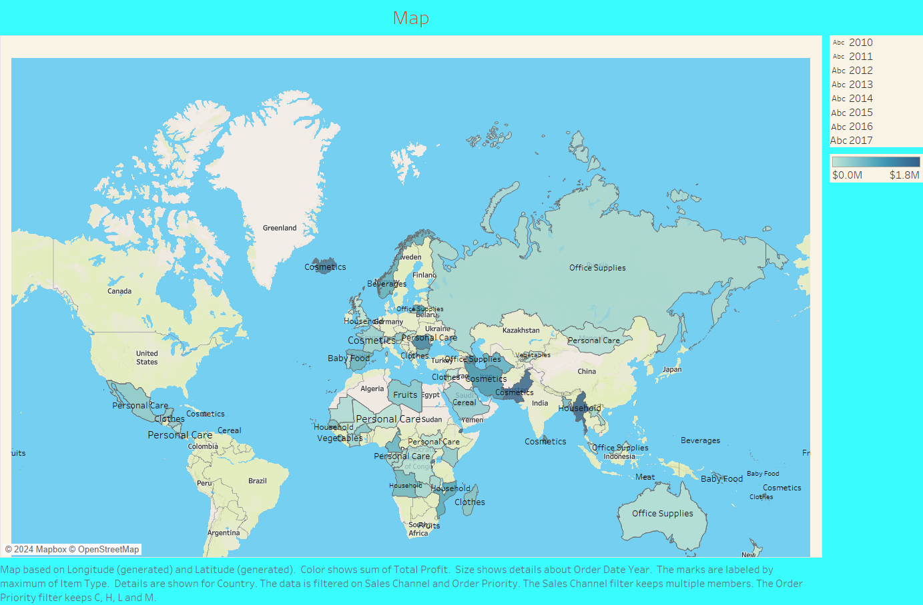

Slide 3
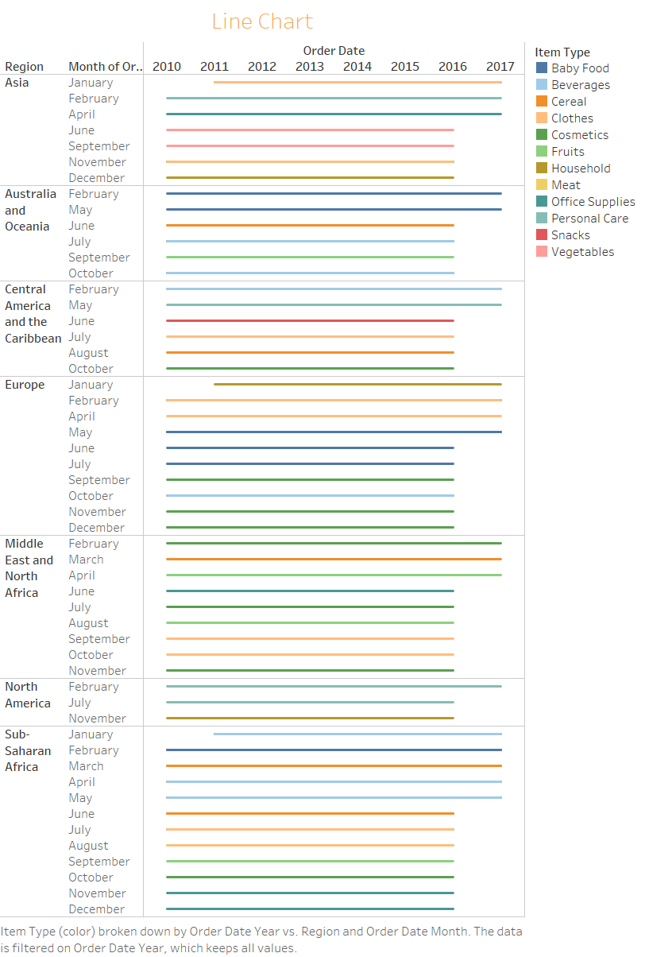

Slide 4


Slide 5


Slide 6
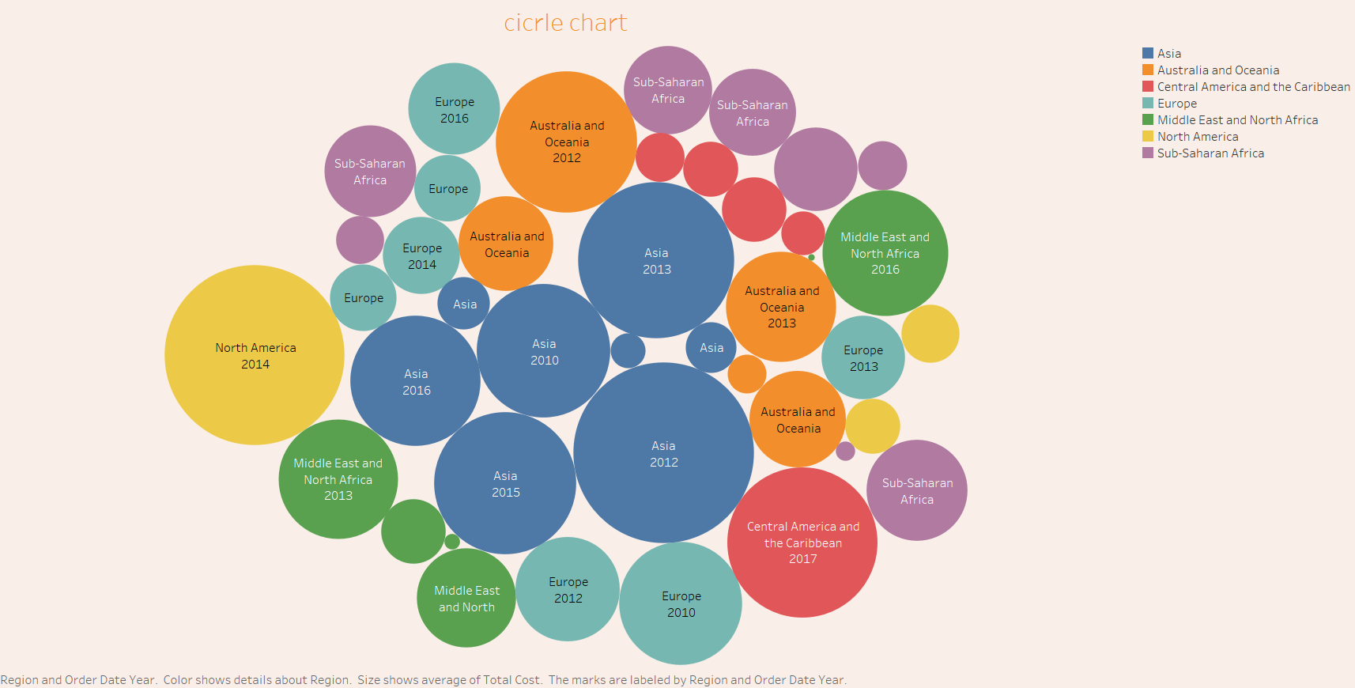

Slide 7
